Slide 1
Philippians 1:3-8
Gospel-Centered Encouragement
Preached by Dan Bridges Amman International Church, Jordan (AmmanChurch.org) Uploaded by Dr. Rick Griffith • Jordan Evangelical Theological Seminary Files in many languages for free download at BibleStudyDownloads.org

Slide 2
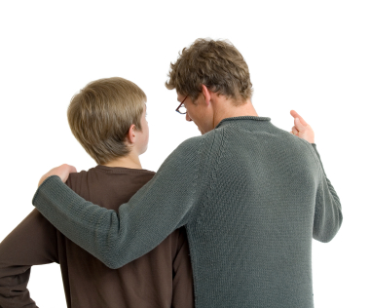
Know Anyone who Needs Encouragement?

Slide 3
How do you identify someone
who needs encouragement?
That person is breathing!
S. Truett Cathy

Slide 4
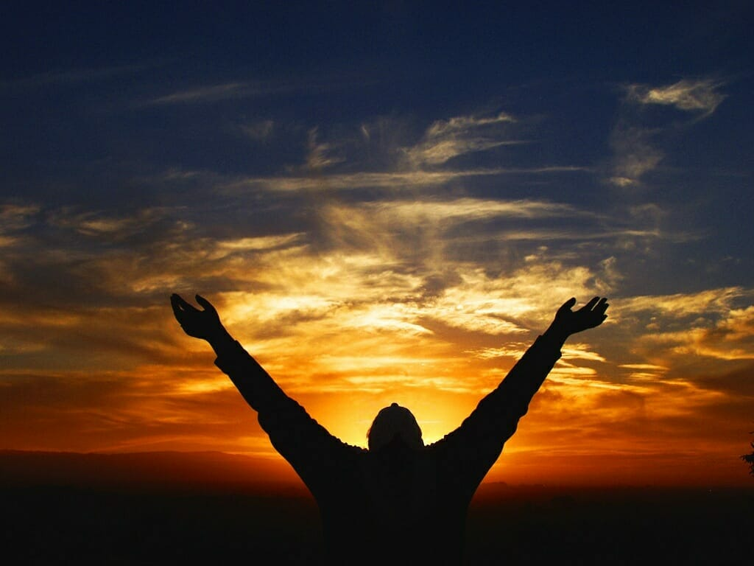
Overall Context: Paul’s Prayer for them
Verses 3-8: Paul’s thankfulness, joy, hope and love as he prayed for the Philippians
Verses 9-11: What Paul prayed for the Philippians
Have you ever received a note like that?

Slide 5
Overall Context: Paul’s Prayer for them
Verses 3-8: Paul’s thankfulness, joy, hope and love as he prayed for the Philippians
Verses 9-11: What Paul prayed for the Philippians
Why do you think Paul included this?

Slide 6
Overall Context: Paul’s Prayer for them
Verses 3-8: Paul’s thankfulness, joy, hope and love as he prayed for the Philippians
Verses 9-11: What Paul prayed for the Philippians
Paul, with his pastor’s heart, is writing to encourage them with truth! But it is “gospel-centered encouragement”!

Slide 7
Overall Context: Paul’s Prayer for them
Verses 3-8: Paul’s thankfulness, joy, hope and love as he prayed for the Philippians
Verses 9-11: What Paul prayed for the Philippians
Let’s take a moment to each think about who we might want to encourage!

Slide 8
³ I thank my God in all my remembrance of you, ⁴ always in every prayer of mine for you all making my prayer with joy, ⁵ because of your partnership in the gospel from the first day until now. ⁶ And I am sure of this, that he who began a good work in you will bring it to completion at the day of Jesus Christ.
Philippians 1:3-6

Slide 9
⁷ It is right for me to feel this way about you all, because I hold you in my heart, for you are all partakers with me of grace, both in my imprisonment and in the defense and confirmation of the gospel. ⁸ For God is my witness, how I yearn for you all with the affection of Christ Jesus.
Philippians 1:7-8

Slide 10
³ I thank my God in all my remembrance of you, ⁴ always in every prayer of mine for you all making my prayer with joy, ⁵ because of your partnership in the gospel from the first day until now. ⁶ And I am sure of this, that he who began a good work in you will bring it to completion at the day of Jesus Christ. ⁷ It is right for me to feel this way about you all, because I hold you in my heart, for you are all partakers with me of grace, both in my imprisonment and in the defense and confirmation of the gospel. ⁸ For God is my witness, how I yearn for you all with the affection of Christ Jesus.
Philippians 1:3-8
This entire passage is one sentence in the Greek!

Slide 11
Three Main Sections:
1. Paul’s Thankfulness and Joy
³ I thank my God in all my remembrance of you, ⁴ always in every prayer of mine for you all making my prayer with joy, ⁵ because of your partnership in the gospel from the first day until now.
Philippians 1:3-5

Slide 12
Three Main Sections:
2. Paul’s Confidence in God’s Work
⁶ And I am sure of this, that he who began a good work in you will bring it to completion at the day of Jesus Christ.
Philippians 1:6

Slide 13
Three Main Sections:
3. Paul’s “Defense” of His Joy & Confidence
⁷ It is right for me to feel this way about you all, because I hold you in my heart, for you are all partakers with me of grace, both in my imprisonment and in the defense and confirmation of the gospel. ⁸ For God is my witness, how I yearn for you all with the affection of Christ Jesus.
Philippians 1:7-8

Slide 14
³ I thank my God in all my remembrance of you, ⁴ always in every prayer of mine for you all making my prayer with joy, ⁵ because of your partnership in the gospel from the first day until now. ⁶ And I am sure of this, that he who began a good work in you will bring it to completion at the day of Jesus Christ. ⁷ It is right for me to feel this way about you all, because I hold you in my heart, for you are all partakers with me of grace, both in my imprisonment and in the defense and confirmation of the gospel. ⁸ For God is my witness, how I yearn for you all with the affection of Christ Jesus.
Philippians 1:3-8
Important Theme

Slide 15
³ I thank my God in all my remembrance of you, ⁴ always in every prayer of mine for you all making my prayer with joy, ⁵ because of your partnership in the gospel from the first day until now. ⁶ And I am sure of this, that he who began a good work in you will bring it to completion at the day of Jesus Christ. ⁷ It is right for me to feel this way about you all, because I hold you in my heart, for you are all partakers with me of grace, both in my imprisonment and in the defense and confirmation of the gospel. ⁸ For God is my witness, how I yearn for you all with the affection of Christ Jesus.
Philippians 1:3-8
koinonia

Slide 16
³ I thank my God in all my remembrance of you, ⁴ always in every prayer of mine for you all making my prayer with joy, ⁵ because of your partnership in the gospel from the first day until now. ⁶ And I am sure of this, that he who began a good work in you will bring it to completion at the day of Jesus Christ. ⁷ It is right for me to feel this way about you all, because I hold you in my heart, for you are all partakers with me of grace, both in my imprisonment and in the defense and confirmation of the gospel. ⁸ For God is my witness, how I yearn for you all with the affection of Christ Jesus.
Philippians 1:3-8
koinōnia
sugkoinōnos

Slide 17
Partnership in the Gospel
koinōnia: participation, communion,
fellowship, to share in
sugkoinōnos: co-participant,
companion with

Slide 18
How did the Philippians Partner in the Gospel?
Hosting Paul’s team
Participating in “church”
Supporting Paul financially many times
Supporting the believers in Jerusalem
Spreading the gospel in Philippi
Supporting Paul in prison

Slide 19
Partnership in the Gospel
“It does not take much reading of Paul’s letters to recognize that the gospel was the singular passion of his life; that passion is the glue that in particular holds this letter together. By ‘the gospel,’ especially in Philippians, Paul refers primarily neither to a body of teaching nor to a proclamation. Above all, the gospel has to do with Christ, both his person and his work.”
Dr. Thomas Constable
Let’s keep Paul’s passion for Jesus in
mind as we go back through what
he says!

Slide 20
Three Main Sections:
1. Paul’s Thankfulness and Joy
³ I thank my God in all my remembrance of you, ⁴ always in every prayer of mine for you all making my prayer with joy, ⁵ because of your partnership in the gospel from the first day until now.
Philippians 1:3-5
Why?
Notes:
This gospel-based encouragement starts with prayer.
This is different thankfulness – it is not thanking God for something he’s done for us, but rather something he’s done for others!

Slide 21
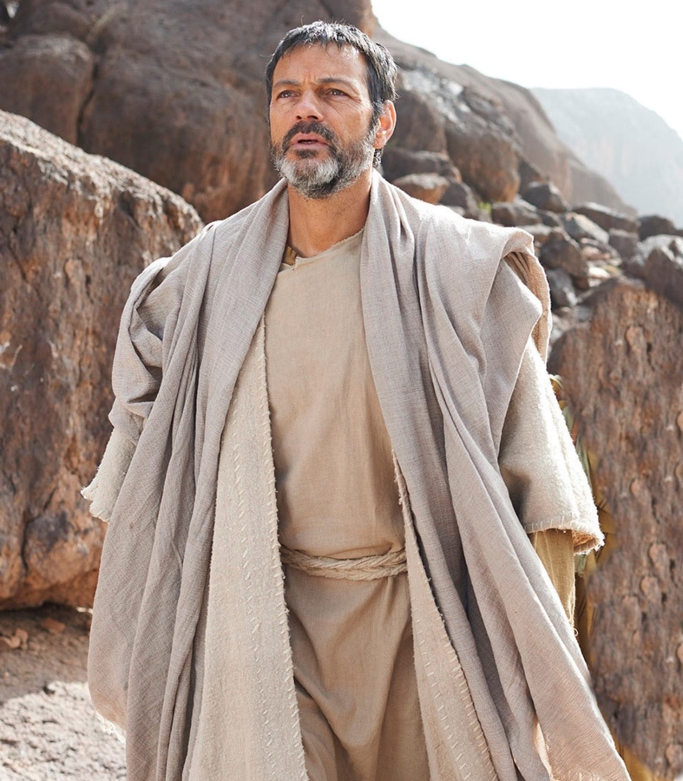
Three Main Sections:
1. Paul’s Thankfulness and Joy
Paul’s joy and thankfulness were
prompted by prayer
based on observing God’s specific work in the lives of the Philippians over the years!

Slide 22
Three Main Sections:
2. Paul’s Confidence in God’s Work
⁶ And I am sure of this, that he who began a good work in you will bring it to completion at the day of Jesus Christ.
How could he be so confident?
Can we confidently say this to all Christians?

Slide 23
Three Main Sections:
3. Paul’s “Defense” of His Joy & Confidence
⁷ It is right for me to feel this way about you all, because I hold you in my heart, for you are all partakers with me of grace, both in my imprisonment and in the defense and confirmation of the gospel. ⁸ For God is my witness, how I yearn for you all with the affection of Christ Jesus.
Philippians 1:7-8
Notes:
It is reasonable for me to have this confidence in God’s future work in your lives. Why? Because I hold you in my heart!

Slide 24
Three Main Sections:
3. Paul’s “Defense” of His Joy & Confidence
⁷ It is right for me to feel this way about you all, because I hold you in my heart, for you are all partakers with me of grace, both in my imprisonment and in the defense and confirmation of the gospel. ⁸ For God is my witness, how I yearn for you all with the affection of Christ Jesus.
Philippians 1:7-8
Notes:
Why do I hold you in my heart? Because, regardless of my situation, you stand with me in the work of the gospel.

Slide 25
Three Main Sections:
3. Paul’s “Defense” of His Joy & Confidence
⁷ It is right for me to feel this way about you all, because I hold you in my heart, for you are all partakers with me of grace, both in my imprisonment and in the defense and confirmation of the gospel. ⁸ For God is my witness, how I yearn for you all with the affection of Christ Jesus.
Philippians 1:7-8
Koinonia – over and over in all situations!
Notes:
Why do I hold you in my heart? Because, regardless of my situation, you stand with me in the work of the gospel.

Slide 26
Three Main Sections:
3. Paul’s “Defense” of His Joy & Confidence
⁷ It is right for me to feel this way about you all, because I hold you in my heart, for you are all partakers with me of grace, both in my imprisonment and in the defense and confirmation of the gospel. ⁸ For God is my witness, how I yearn for you all with the affection of Christ Jesus.
Philippians 1:7-8
Notes:
God has put the love that Jesus has for you in my heart!

Slide 27
Three Main Sections:
3. Paul’s “Defense” of His Joy & Confidence
So why is it “reasonable” for Paul to have such confidence in God’s future work in their lives?
He had seen their partnership with him in the gospel in all different situations in the past.
God had put the love of Jesus for the Philippians in Paul’s heart!
Notes:
God has put the love that Jesus has for you in my heart!

Slide 28
Summary:
Paul was praying for the Philippians’ spiritual growth
Paul’s prayers were filled with joy and thankfulness
→ Because of God’s fingerprints in their lives
Paul was confident of their future growth
→ Because of God’s fingerprints in their lives
→ Because of the supernatural love God had put in
Paul’s heart for the Philippians
Notes:
God has put the love that Jesus has for you in my heart!

Slide 29
This is essentially a Story
This is the story of how Paul encouraged the Philippians. The exact details may not apply in our relationships.
But what truths can we apply? What are the general principles of gospel-centered encouragement?
Notes:
God has put the love that Jesus has for you in my heart!

Slide 30
Gospel-Centered Encouragement
It all starts with loving Jesus!
Pray for people’s spiritual growth
Look for God’s “fingerprints” in their lives and
thank (praise!) God for that
Tell them the work we see God doing in their lives
As God gives us faith, tell them what we believe God will continue to do in their lives (“he who began a good work in you…”)
Joy!
Notes:
God has put the love that Jesus has for you in my heart!

Slide 31
How is Gospel-Centered Encouragement
Different from Ordinary Encouragement?
Ordinary human encouragement is between two people
Gospel-centered encouragement is first partnership with God as he works in people’s lives and then between two people
Notes:
God has put the love that Jesus has for you in my heart!

Slide 32
Who do you know who needs gospel-centered encouragement?
Who do you know who encourages people in this way?
Notes:
God has put the love that Jesus has for you in my heart!

Slide 34
NT Preaching link at BibleStudyDownloads.org
Get this presentation for free!
Notes:
NT Preaching (np)

